Slide 1
Software QA and Testing with Automation using Selenium IDE Course 1, Class 2 Deck 1 The SDLC
Instructor
David F Wagoner
PMP, CSQE, CMQ/OE

Slide 2
The SDLC
The SDLC
Defines the major phases of a software development project
May have a conceptual phase before planning
May have a user acceptance phase for systems developed for a specific client(s)
There are many different models that have similar phases
Disregard Big Bang and Code and Fix from textbook

Slide 3
Common SDLC Phases
Regardless of the specific model, software projects use phases like these, in one form or term or another
Planning
Defines what we are doing
Integrate distinct groups and integral processes to the project
Requirements Development
Defines what we are building
Design
Defines how we are building the software
Coding or Implementation
Build it
Systems Testing
Verify what we built is correct
User Acceptance Testing
Did we build the right thing?
Does it perform aligned with requirements
Deployment
Deliver and checkout what was built

Slide 4
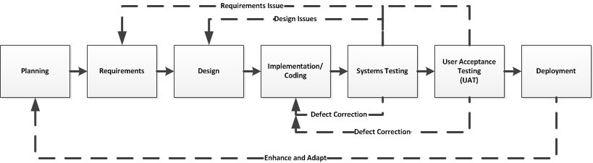
SDLC Phases with Test Rework
This represents the looping that can occur when:
A defect is encountered
A requirement is not met
The later in the process these are seen, the greater the cost to remediate
To:
Correct defects (expensive)
Or designs and requirements (more expensive)
Enhance the software based on evolving user needs or software problems (very expensive)

Slide 5
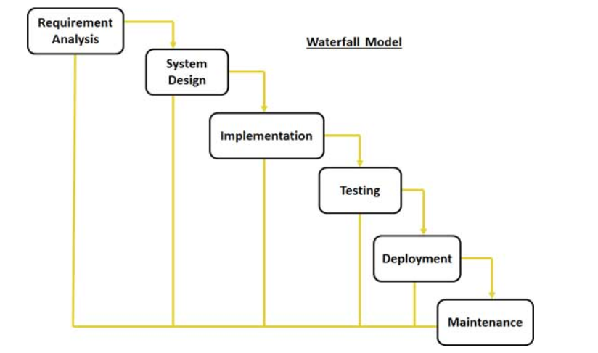
SDLC Models (Waterfall)
This is the oldest and simplest model. Phases occur one after another, which does not always model real-world projects
Image courtesy of tutorialpoints.com

Slide 6
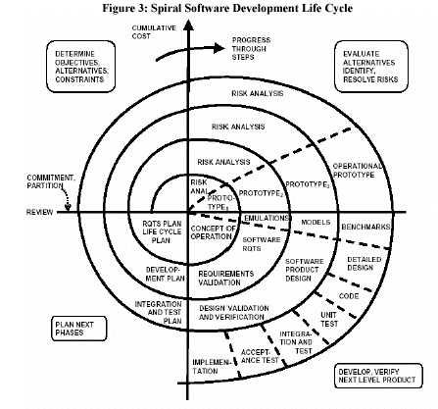
SDLC Models (Spiral)
The Spiral model is a more realistic model that still has phases similar to Waterfall, but lays the phases out in multiple iterations with risk management and re-planning between phases that enhances risk management
Image courtesy of FDIC OIG Audits

Slide 7
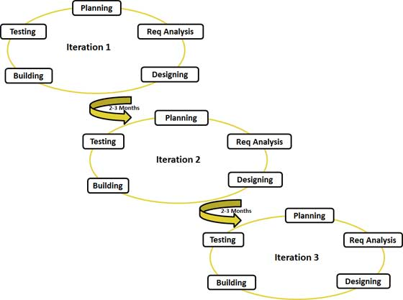
Agile SDLC
Agile Iterative Model
Image courtesy of tutorialpoints.com

Slide 8
SDLC Models (Agile)
The Agile model is the most modern and is widely used today by leading software organizations. It provides a shorter time-to-deployment with more requirements delivered than traditional models like Waterfall and Spiral
It is almost a combination of Waterfall and Spiral with less documentation and overhead
Agile is:
Adaptive instead of predictive
Iterative instead of waterfall
Value code instead of documentation

Slide 9
SDLC Models (Agile - cont)
Agile is based on a Manifesto that sought to overcome difficulties in projects by aligning to a set of engineering values:
Our highest priority is to satisfy the customer through early and continuous delivery of valuable software.
Welcome changing requirements, even late in development. Agile processes harness change for the customer's competitive advantage.
Deliver working software frequently, from a couple of weeks to a couple of months, with a preference to the shorter timescale.
Business people and developers must work together daily throughout the project.

Slide 10
SDLC Models (Agile - cont)
Manifesto (cont.)
Build projects around motivated individuals. Give them the environment and support they need, and trust them to get the job done.
The most efficient and effective method of conveying information to and within a development team is face-to-face conversation.
Working software is the primary measure of progress.
Agile processes promote sustainable development. The sponsors, developers, and users should be able to maintain a constant pace indefinitely.

Slide 11
SDLC Models (Agile - cont)
Manifesto (cont.)
Continuous attention to technical excellence and good design enhances agility.
Simplicity--the art of maximizing the amount of work not done--is essential.
The best architectures, requirements, and designs emerge from self-organizing teams.
At regular intervals, the team reflects on how to become more effective, then tunes and adjusts its behavior accordingly

Slide 12
SDLC Integral Processes
These processes interweave with the main phases and provide engineering support to the main development team
Configuration Management
Quality Assurance
Documentation Development
Training Development, if applicable
Testing is often considered an integral process but is different in that it has a main phases in the SDLC

Slide 13
Testing Life Cycle
The testing lifecycle roughly correlates to similar phases of SDLC
Test planning is conducted during the Planning phase
Requirements for testing are documented during Requirements Development phase
Test case/script design occurs during the Design phase
Test case construction occurs during the Coding or Implementation phase
Test execution occurs during the Systems Test phase
If User Acceptance Testing is applicable, it is performed prior to delivery and is supported by the Testing Team

Slide 14
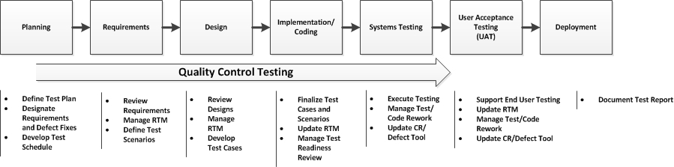
Testing Life Cycle/Integral Process

Slide 15
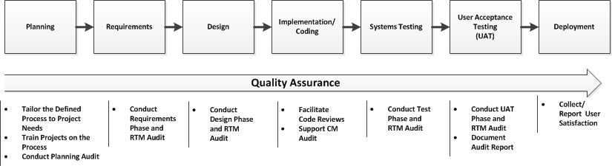
QA Life Cycle/Integral Process

Slide 16
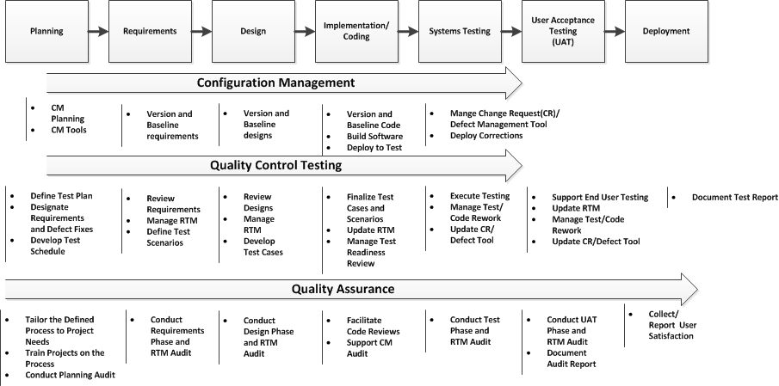
All Life Cycles/Integral Processes

